Slide 1

BI Adoption and Implementation in Lakhani
Project Proposal
By: Team 11
Shirin Javadi
Vishal Patidar
Mehrdad Shoeibi
Solomiya Sorokotyaha
Advisor: Prof. Kordzadeh

Slide 2

TABLE OF CONTENTS
01
02
03
04
Introduction
Proposed BI Solution
Prototypes
Implementation
05
Summary and Conclusion
1

Slide 3

Introduction
2

Slide 4

Lakhani Shoes
Location
Website
Founded
India
www.lakhanifootwear.com
1986
Employees
Capacity
Distribution Network
220
55.5 million pairs per year
350
3

Slide 5

Business Problem
01
02
03
04
Expansion Goal
Unknown Customer Behavior
Data Utilization
BI Adoption
4

Slide 6


Case Study 1: Adidas and BI
Operational Efficiency
Core processes across the entire value chain digitalized
Product Innovation
Creation process with 3D design capabilities
Sales Growth
Personalized offers for online purchases
Management Optimization
Improve order, inventory, and purchasing processes.
5

Slide 7
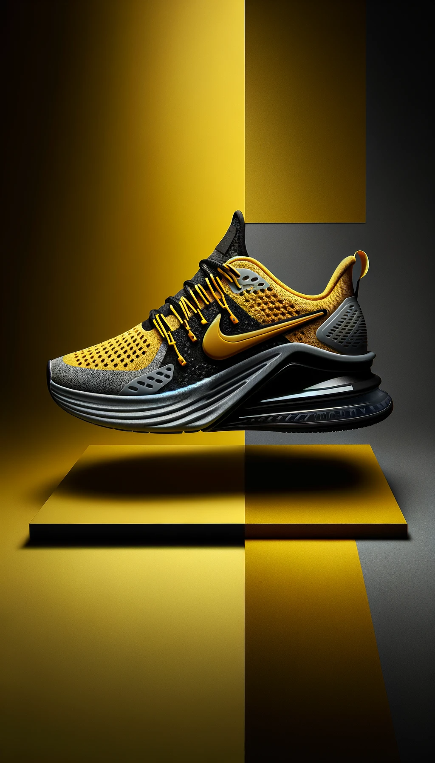
Case Study 2: Nike and BI
Excess Inventory and Stock Shortages
Demand Forecasting for Inventory Balance
Misalignment with Consumer Trends
Trend Analysis for Product Alignment
Rigid Supply Chain Operations
Supply Chain Agility through Real-Time Data
Inefficient Marketing Spend
ROI Tracking for Marketing Optimization
6

Slide 8

Proposed BI Solution
BI , Components, Rule and Values
7

Slide 9







Components of BI solution
Data Sources
ETL process
Data Warehousing
Data Analytics
Visualization
Decision
8

Slide 10

People
Processes
Sales Department
Human Resource
Product Design
Expanding to the US Market
Resource Management
Customer Trends and Behavior Analysis
Management
Governance
Data Quality and Cleaning
Integrations
KPIs
Data Governance Plan
Ensure Data Integrity
9

Slide 11
Our offer and BI Benefits
Ready-To-Use HR Tableau Dashboard
Example of a Sales Operational Dashboard
BONUS: Customer Review analysis Prototype
Includes Sales Data, HR Metrics, and Consumer Sentiment Analysis from Industry Competitors
Implementation Plan and Guidelines
Full Support During the Implementation Timeline
We will help you get to the top!
10

Slide 12
Our offer and BI Benefits
Define and Set the Sales Goals
Helicopter View on the Company Human Resource State
Track Important KPIs
Improved Transparency and Digitalization
Get to Know Your Customer
Finally, Make More Profitable Decisions
We will help you get to the top!
11

Slide 13

Prototypes
12

Slide 14

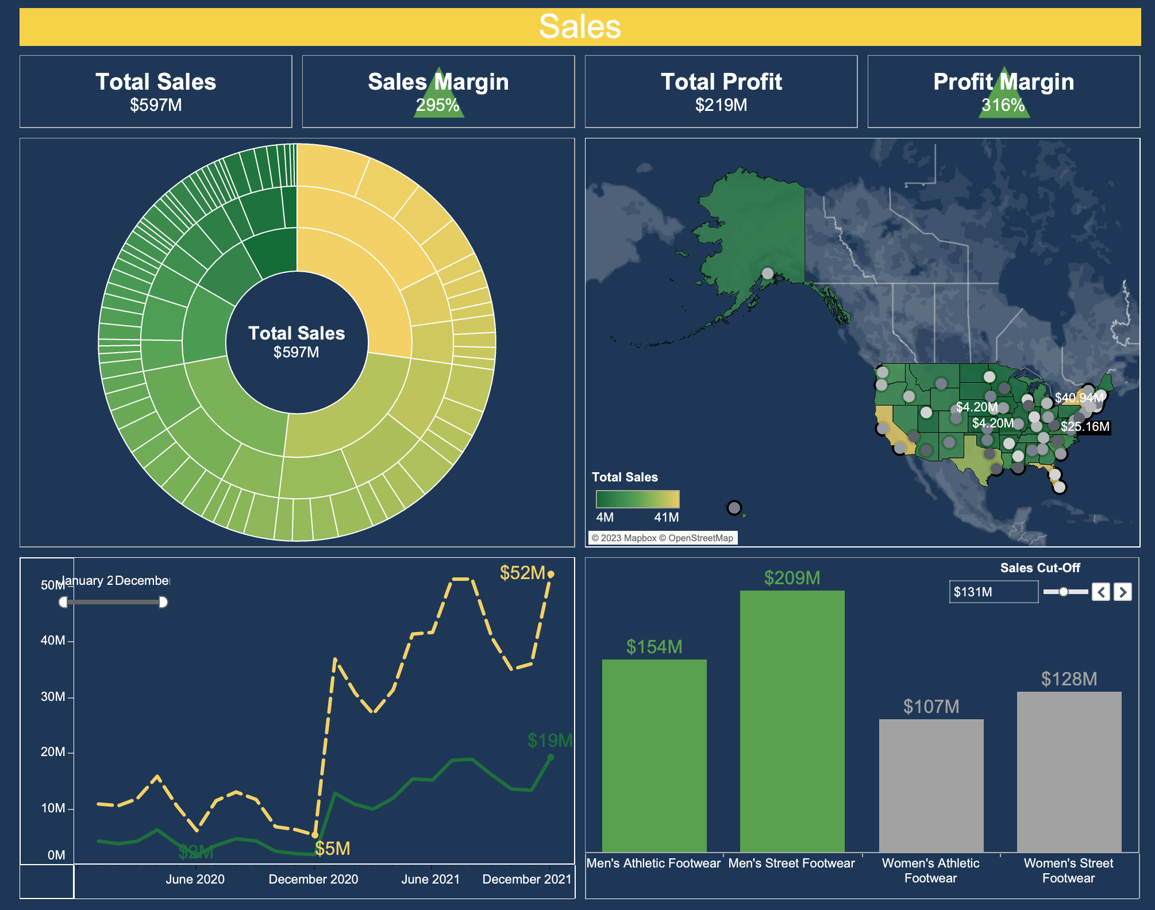
13
Notes:
Open Tableau for first dashboard (Sales)

Slide 15
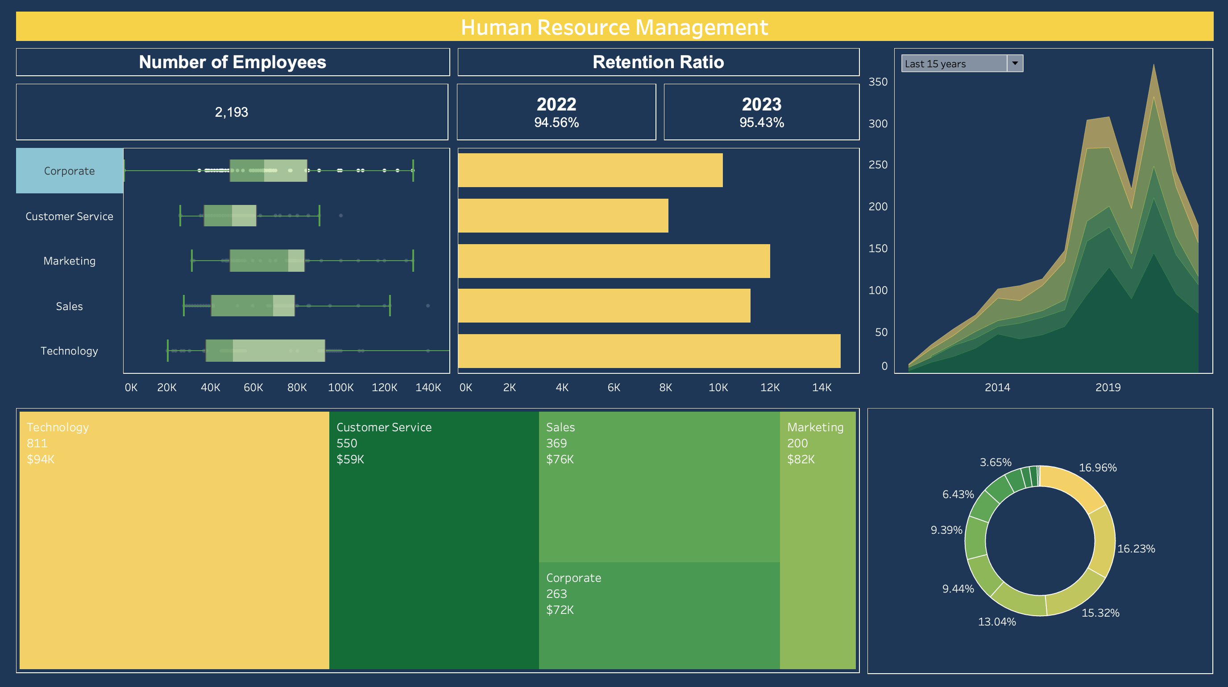
14
Notes:
Open Tableau second dashboard for Human Resource!

Slide 16
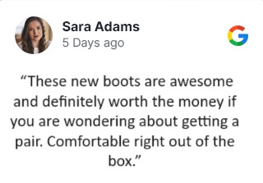
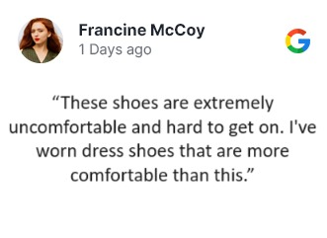

Reviews Sentiment analysis
Score: 0.59
Neutral
Negative
Positive
Score: 0.00001
Score: 0.99
15

Slide 17
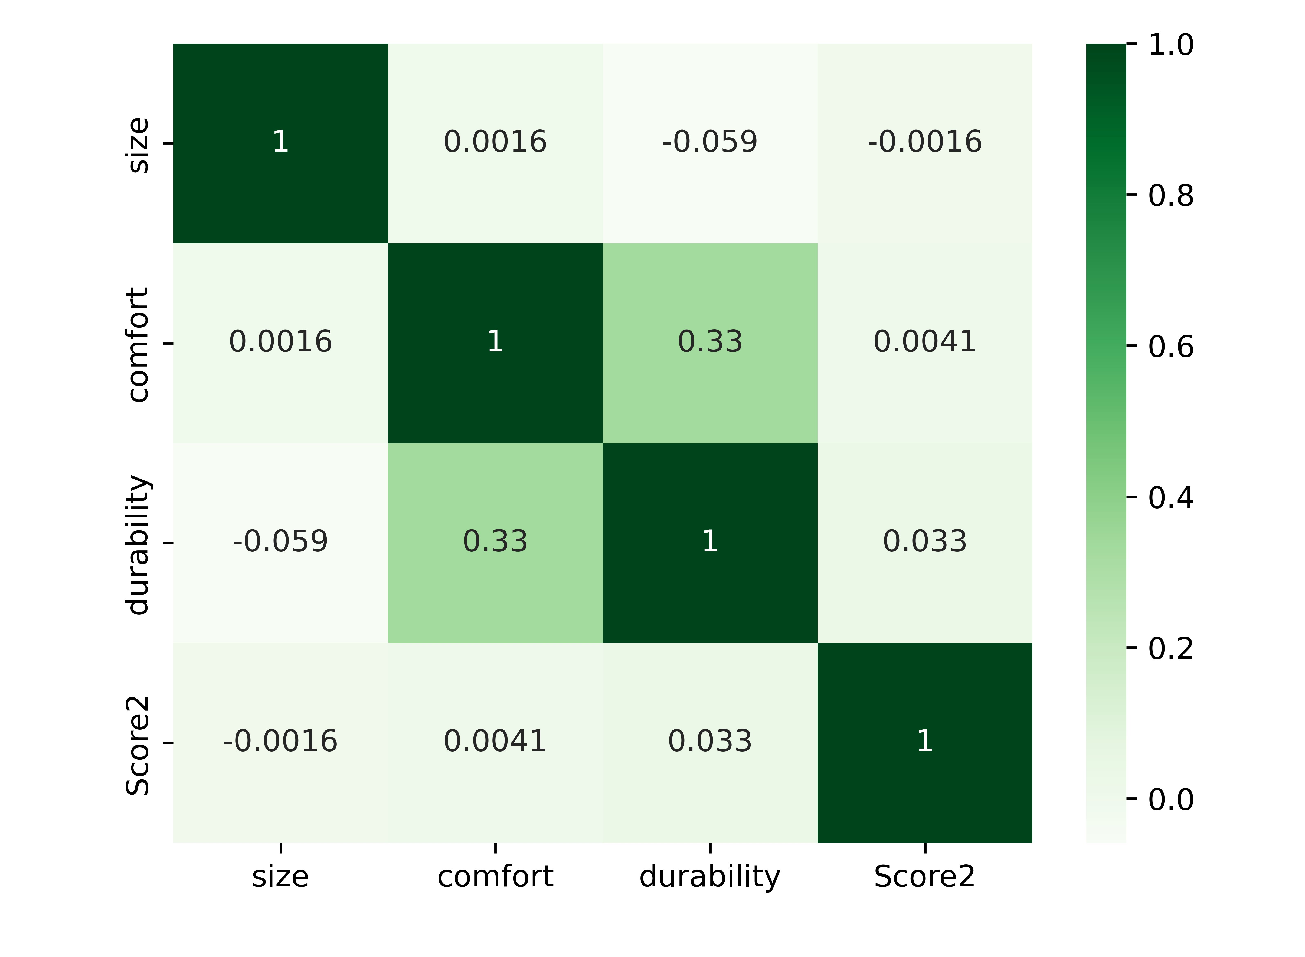
Features correlations
16

Slide 18
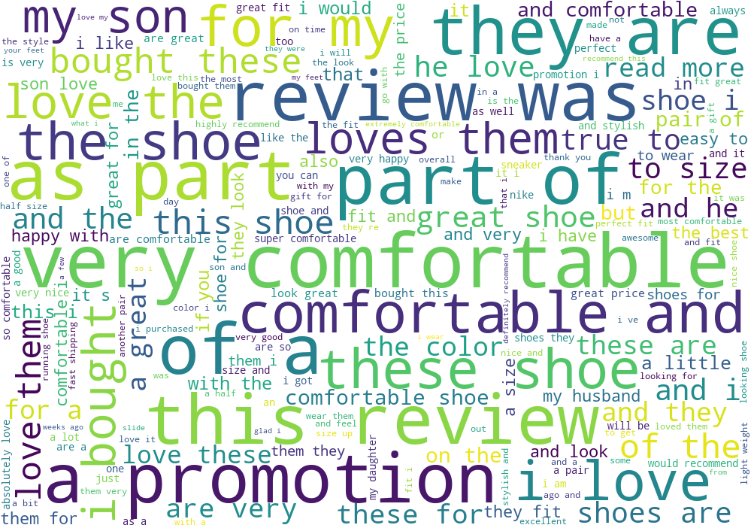
17
Notes:
What exactly our reviews are saying? Reading through 25k of text reviews might not be a worthy time investment (if achievable at all) So here our team developed a visualization of words and phrases in their relative frequency of usage in the reviews. We can note that the most frequent and most important is comfort, love the, for my. Even from a simple glance we can derive an understanding of general customer attitude towards our product.
But I already see the question in your eyes: how can Lakhani get to that point of benefiting from data starting tomorrow? Vishal has a step by step plan for you!

Slide 19

Implementation
18

Slide 20
Implementation process
Identify Existing Data Sources
Inventory All Data Sources.
Define Data Quality Standards.
Data Warehouse ( e.g. SQL Database)
Establish ETL Process.
Data Analytics and Visualization (Like our Tableau Dashboards!)
Decision Making
19

Slide 21
Future Opportunities
Potential Challenges
Data Quality Issues.
System Development & Integration.
Costly to Implement BI
Legal Issues.
Ethical Issues.
Enhanced Market Understanding
Strategic Expansion
Optimized Operations
Agile (quick) decision- making
Competitive Advantage
Innovation Opportunities
Sustainable Growth
Improved Customer experience
Customer retention & Loyalty
20

Slide 22

Summary and Conclusion
21

Slide 23
Conclusion
Empowering Lakhani: Leveraging BI Analytics for Successful Entry into the US Market"
Leveraging the Untapped Potential of Data Analytics: Empowering Lakhani's Journey
Empowering Departments: Implementing Interactive Dashboards Tailored to Departmental Data for Informed, Data-Driven Decision-Making
Crafting an Implementation Roadmap for Embracing Business Intelligence Adoption
22

Slide 24
References
https://en.wikipedia.org/wiki/Nike,_Inc.
https://en.wikipedia.org/wiki/Adidas
https://www.lakhanifootwear.com/about-us.html
https://www.kaggle.com/datasets/heemalichaudhari/adidas-sales-dataset/
https://www.kaggle.com/datasets/koluit/human-resource-data-set-the-company
https://bisolutionsinc.com/about-us/
https://rsmus.com/industries/asset-management.html
https://www.kotterinc.com/methodology/gad_source=1&gclid=Cj0KCQiAsburBhCIARIsAExmsu6DzbKAAewYPsZlu-dhsngTspZihGtjcqAVICI51zOYcB0fFnthVN0aAiJbEALw_wcB&gclsrc=aw.ds
23

Slide 25

Thank You!

